Slide 1



Full Stack Web Development using MERN stack
Session 1 | 21 Sep 2021
By Prashant Tomer
9013398220

Slide 2
Agenda
Introduction to Full Stack Development
Different Technologies for Full Stack Development
Java Script Based Full Stack Development
Tools Required for Development
Building MERN Development Environment

Slide 3
What is Full Stack Web Development?
It require two kinds development
Front-End Development
Back-End Development
Front-End means something that is visible to users
Back-End means something used for processing purpose but not directly visible to the users

Slide 4


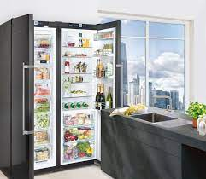
Real Life Example
Back-End
Front-End
Database

Slide 5
Components of Full Stack Development
Full Stack Development
Front-End Development
Back-End Development
Database
Rest API
Web Application Architecture
Design Pattern
Version Control System

Slide 6
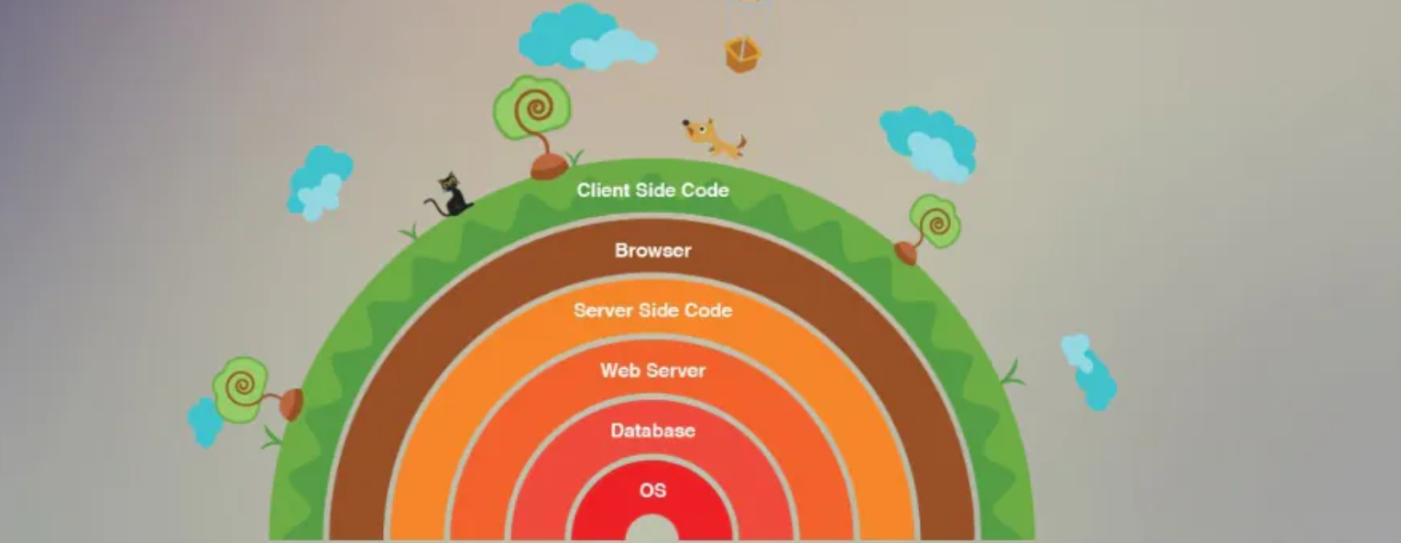
Layers in Full Stack Development

Slide 7
Front-End Technologies, Libraries and Frameworks
HTML
CSS
JavaScript
jQuery
AJAX
ReactJS
AngularJS
VueJS
Ember
Backbone
BootStrap

Slide 8
Server Side Technologies and Frameworks
Java (Spring)
JavaScript (ExpressJS)
PHP (Laravel)
Python (Django, Flask, Pylons)
C# (ASP.NET)
Ruby (Ruby on Rail)
Scala (Play)

Slide 9
Databases
MySQL
MongoDB
PostgreSQL
CouchDB
Redis
Neo4J
Oracle
SQL Server
Firebase

Slide 10
Server Technologies
Apache
Nginx
IIS
NodeJS

Slide 11
JavaScript based Stacks
MEAN Stack (MongoDB Express Angular Node)
MERN Stack (MongoDB Express React Node)
MEVN Stack (MongoDB Express Vue Node)
MongoDB – document database
Express(.js) – Server Side Framework
React(.js) – A client side JavaScript Library
Node(.js) – A premier JavaScript Web Server
https://reactjs.org
http://expressjs.com/
https://www.mongodb.com
https://nodejs.org

Slide 12
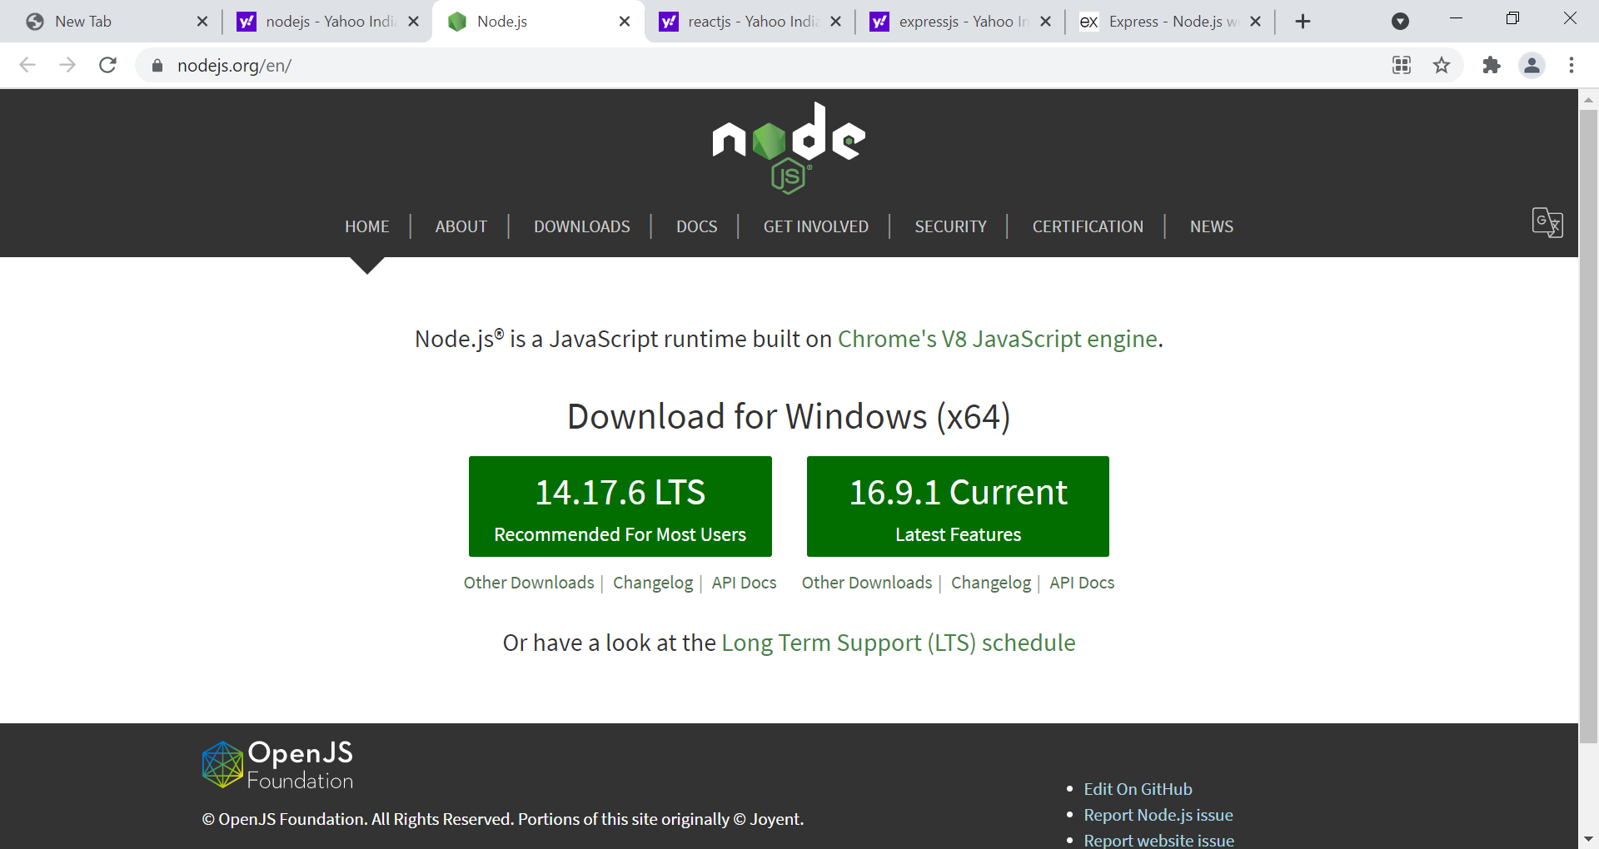
Installing and testing for NodeJS and its tools
Install the NodeJS tool from https://nodejs.org

Slide 13
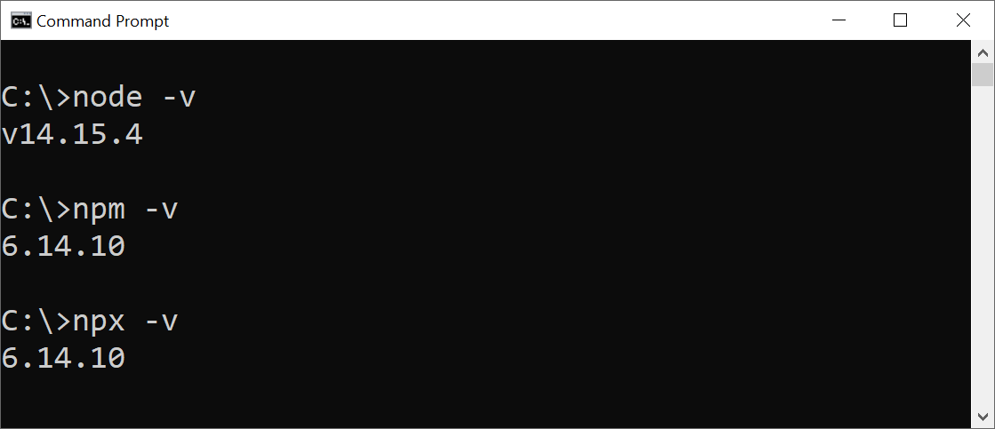
Check for Node Tools

Slide 14
From where to start with?
Quick Understanding of Front-End Technologies
HTML
CSS
JavaScript
jQuery

Slide 15
Queries
Ask your queries

